Slide 1
AVIONICS WEEK 8 PROGRESS REPORT Presented by James Macharia

Slide 2
Tasks Completed last week
Due to the trip to Malindi Space Centre not much was done during the week though some tasks were done while others are still in progress
The new PCB was soldered and tests for continuity were conducted
A new flight software has been worked on
We established that the FPV camera Tx is beyond salvage

Slide 3
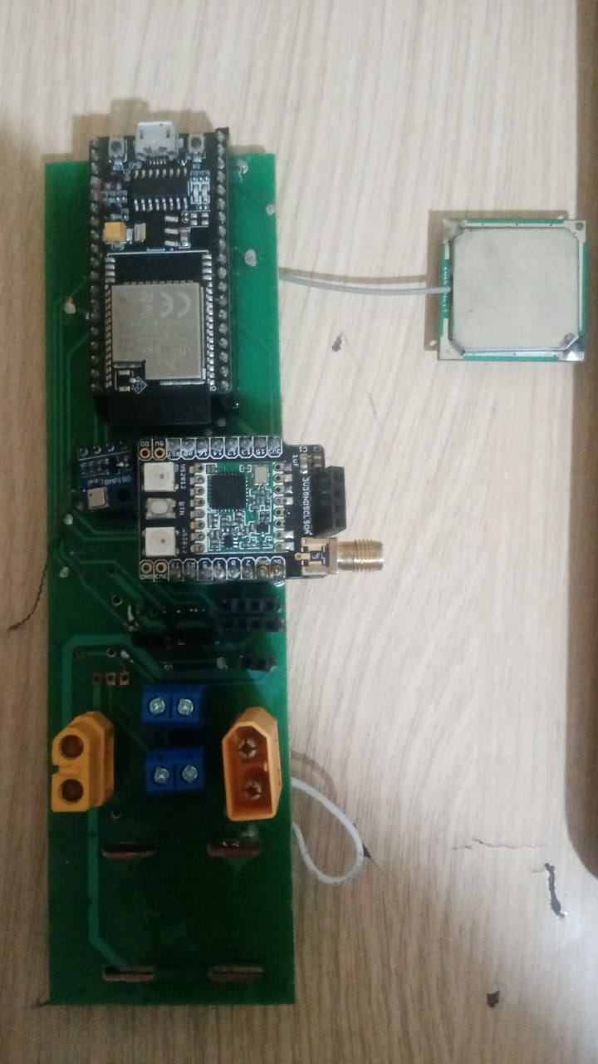
Soldering of the new PCB

Slide 4
Configuration of a new RTOS
A new Real Time Operating System was configured
First core- Fetching Telemetry data and writing to SD card#
Second core-Transmitting the data using Lora

Slide 5
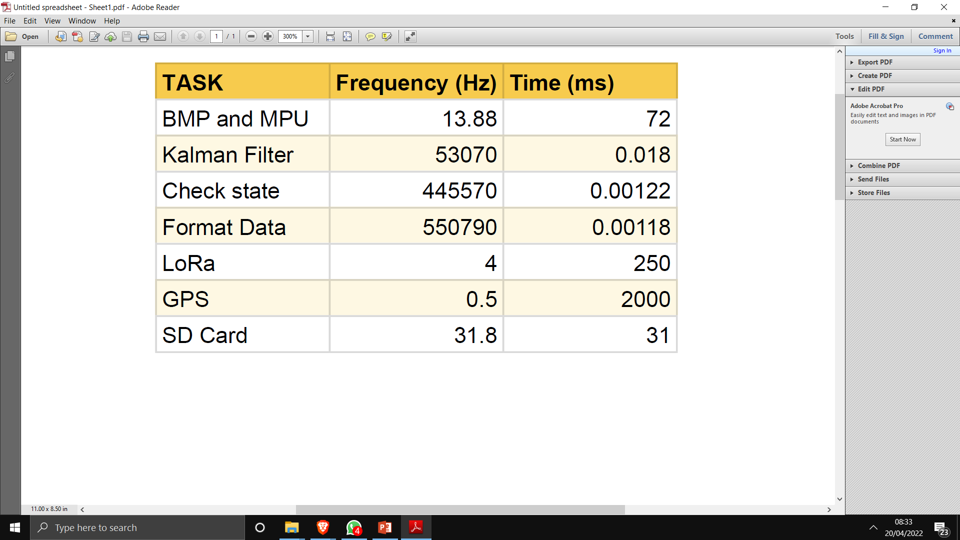
RTOS Guide

Slide 6
Challenges Faced
The software does not run on the PCB and we are yet to establish the problem
LoRa datastream is generally slow hence the team will be migrating to Wifi after the testflight

Slide 7
FPV CAMERA
It was established that the FPV camera transmitter was beyond salvage
However the receiver is perfectly fine and functional
We will be requesting another transmitter from Pixel Electronics in the course of the day
The camera setup might be ready on time for the test flight if the transmitter is delivered on time

Slide 8
Tasks This Week
Fabricate New PCB
Integration of Flight Control

